Slide 1
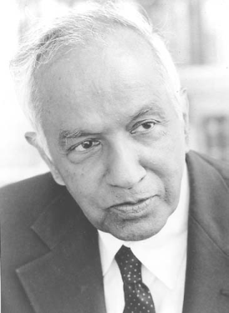
Subrahmanyan Chandrasekhar
Notes:
# Name Subrahmanyan Chandrasekhar # Textbook Knight, Physics for Scientists and Engineers: A Strategic Approach with Modern Physics, 3rd Edition, Chapter 13 Knight, Physics for Scientists and Engineers: A Strategic Approach with Modern Physics, 3rd Edition, Chapter 37 # Photo https://upload.wikimedia.org/wikipedia/en/3/3a/ChandraNobel.png # Description Indian physicist, worked on wide range of astrophysical problems. Developed a theory about the structure of white dwarf stars, placed upper limit on mass of white dwarf stars.

